Slide 1


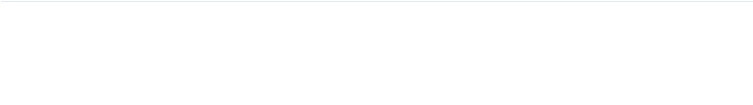
Crop Disease Detection and Fertilizer Recommendation System
Presented by: M V Abhiram - 23R11A66P3

Slide 2

Problem Domain & Motivation
Agricultural Crisis
Theoretical Gaps
Crop diseases cause global yield losses. Manual diagnosis is subjective and slow. Farmers lack data-driven recommendation systems for fertilizer optimization.
Limited research exists on integrating Deep Learning with Explainable AI in agriculture. There is a need for transparent, automated decision support.

Slide 3
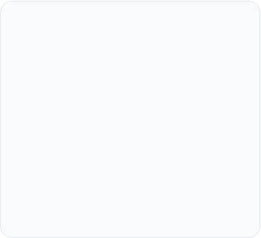
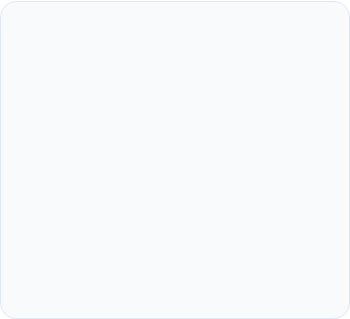
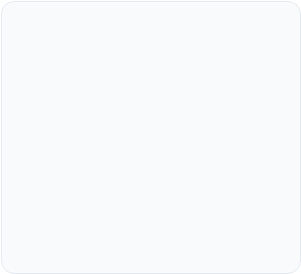



Objectives & Goals
Deep Vision
Ensemble Logic
Interpretable AI
Apply CNN architectures to multi-class Recognition of 59 crop-disease pairs via hierarchical feature extraction.
Implement AdaBoost for weighted error correction across heterogeneous feature sets (Soil, Crop, Environment).
Utilize SHAP framework to provide mathematical transparency via feature attribution for end-user trust.

Slide 4
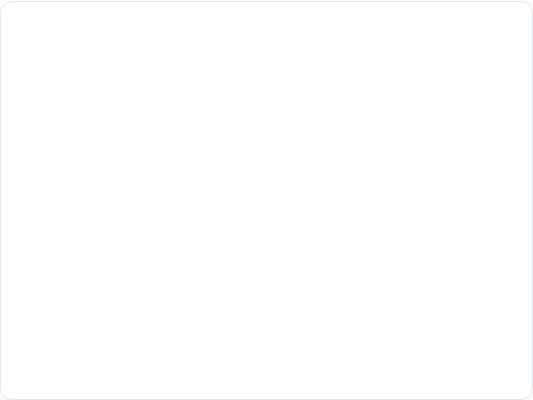
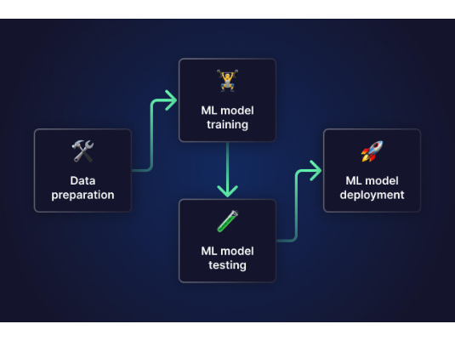
System Architecture & Design
The architecture follows key design principles : Modularity, Interpretability, and Scalability.
CNN Pipeline: Feature extraction from raw pixel data.
Engineering: Scaling and encoding for tabular processing.
AdaBoost: Iterative ensemble prediction engine.
SHAP Layer: Calculation of feature attribution scores.

Slide 5
Dataset Theoretical Considerations
Parameter | CNN Dataset (Image) | AdaBoost Dataset (Tabular)
Sample Size | 61,955 RGB Images | 10,000 Data Records
Complexity | 59 Disease Categories | 8 Heterogeneous Features
Theory Focus | Invariance & Pattern Recognition | Feature Interaction & Attribution
Challenges | Class Imbalance & Overfitting | Numeric/Categorical Encoding

Slide 6
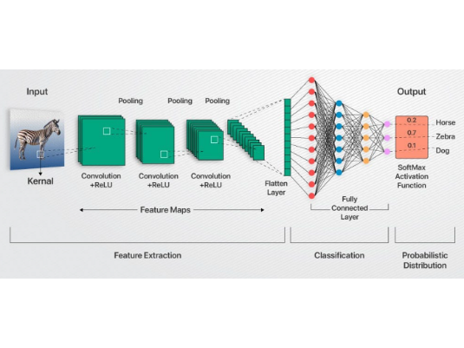
CNN Architecture
Hierarchical Structure
Convolution: Local connectivity & parameter sharing.
MaxPooling: Translation invariance & efficiency.
Dropout (0.25): Regularization to prevent neuron co-adaptation.
Softmax: Probability distribution for multi-class labels.

Slide 7
Feature Extraction Learning
Low to Mid Level
High Level Representation
Early layers focus on Local Patterns: edges, textures, and color gradients. Mid-layers identify Complex Shapes such as leaf venation or necrotic spots.
Deep layers capture Semantic Concepts: object parts and global structures. This progressive abstraction mimics biological vision for robust classification.

Slide 8
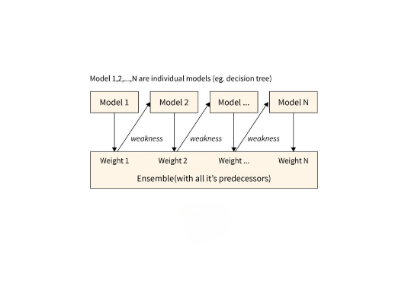
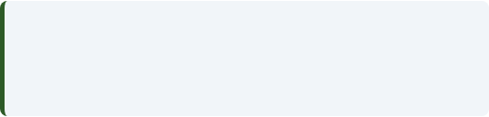
AdaBoost Ensemble Framework
AdaBoost combines multiple Weak Learners (Decision Trees) into a Strong Learner via weighted iteration.
Learner Weight Calculation:
Sample weights are increased for misclassified instances, forcing the ensemble to focus on "hard" cases.

Slide 9
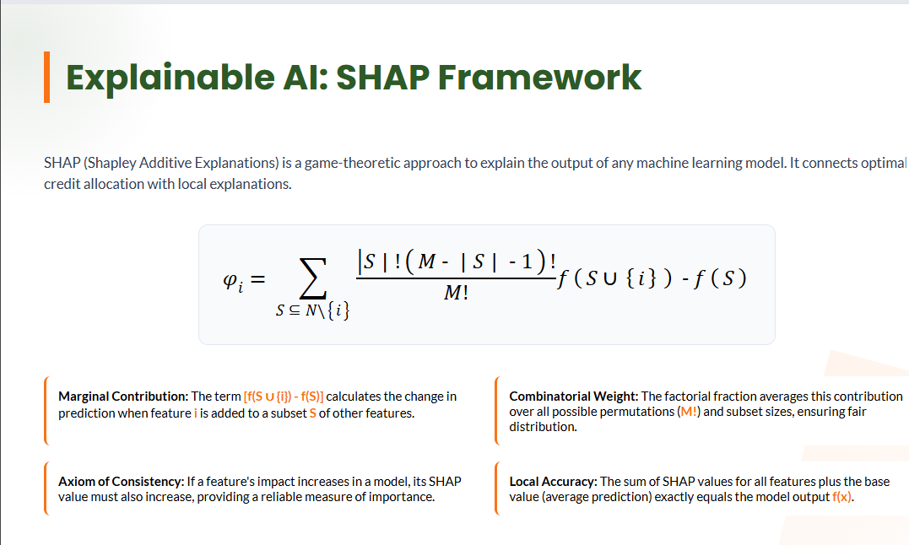

Slide 10
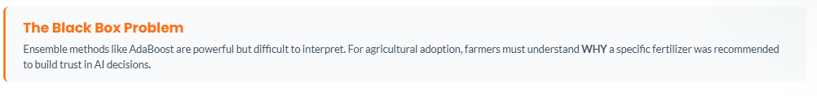
Why only SHAP? Explainability Framework from Game Theory
Model Compatibility
Works with AdaBoost (model-agnostic)
Applicable to both CNN & tabular models
• Interpretability
Clearly explains why a recommendation is made
Provides feature-level impact
• Fairness & Transparency
Unbiased feature contribution
Improves overall system transparency
• Trust & Reliability
Builds farmer confidence
Strong theoretical base

Slide 11
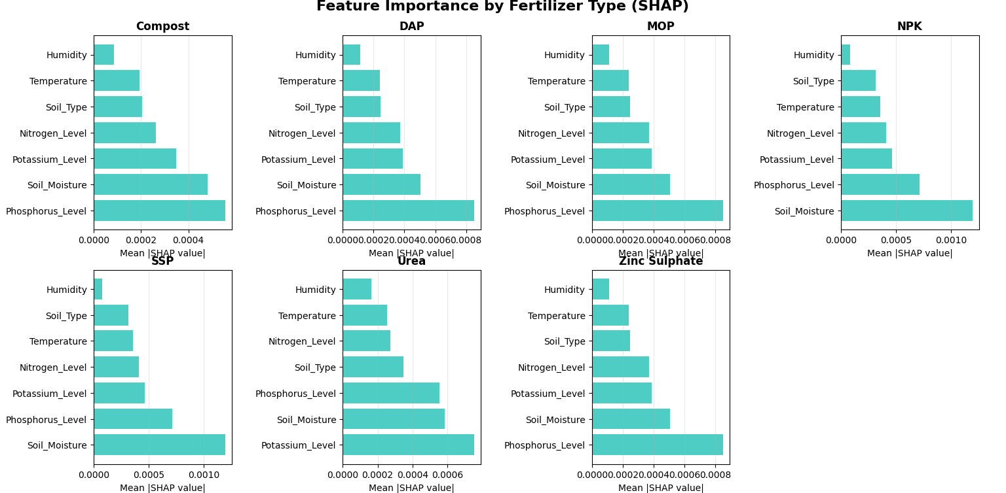

Slide 12
System Integration & Workflow
Context
Explain
Merging crop type with user-provided soil metadata.
SHAP generates attribution scores for the outcome.
CNN Stage
Ensemble
Output
Image input to disease classification via Deep Learning.
AdaBoost predicts optimal fertilizer recommendation.
Interpretable result provided to the end-user.

Slide 13
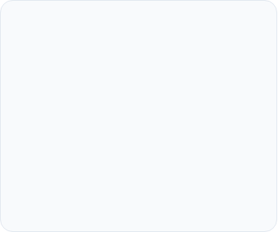
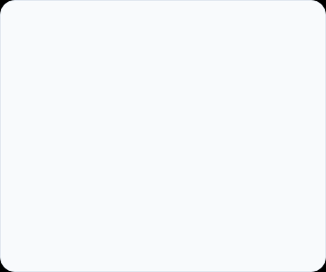
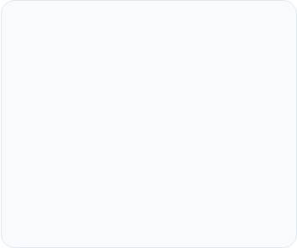



Theoretical Contributions
Multi-Paradigm
Domain XAI
Robustness
Seamless integration of Deep Vision (CNN) and Tabular Ensemble (AdaBoost) frameworks.
Applying Shapley Values to Agri-Tech for validated transparency in farm-level advice.
Practical application of Augmentation theory to stabilize performance in varied field lighting.

Slide 14
Implementation Challenges
Challenge | Solution
Overfitting | Dropout & Early Stopping Regularization
Feature Scaling | StandardScaler (Mean=0, Std=1) normalization
Complexity | Kernel Sampling & Approximation in SHAP
Heterogeneity | Multi-modal Label & One-Hot Encoding
Multi-Class | Progressive Filter Depth (32 → 64 → 128)

Slide 15
Comparative Analysis
CNN vs. Baseline
SHAP vs. LIME
CNN leverages Parameter Sharing and Hierarchical Learning, outperforming SVM and KNN which fail to capture spatial hierarchies in image data.
Unlike LIME's local linear approximations, SHAP satisfies Efficiency & Symmetry axioms, ensuring globally consistent feature importance across all predictions.

Slide 16
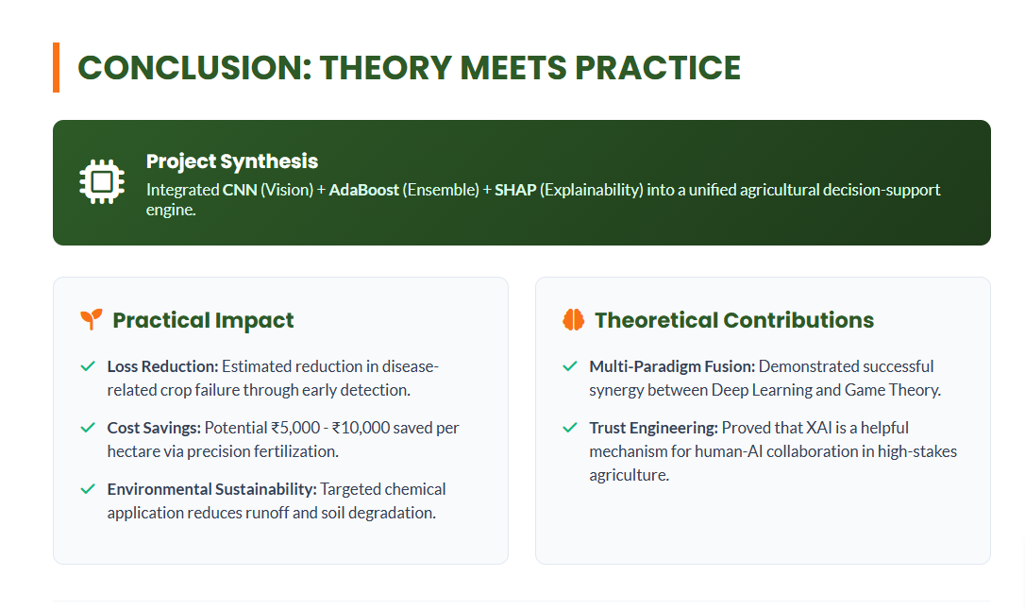

Slide 17
